Slide 1

Luke 19
Presented by

Slide 2


Slide 3


Slide 4


Slide 5


Slide 6


Slide 7


Slide 8


Slide 9
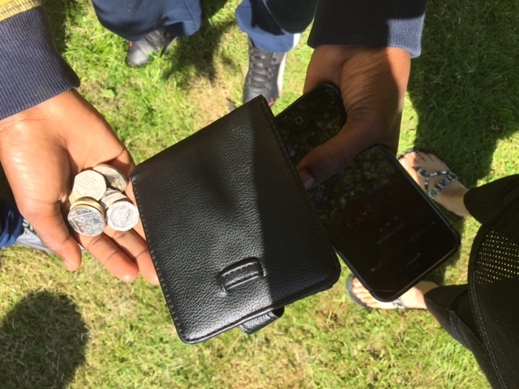

Slide 10


Slide 11
Jesus said to him, "Today salvation has come to this house, because this man, too, is a son of Abraham.
For the Son of Man came to seek and to save the lost."

