Slide 1
Zacchaeus
Small man…big problem

Slide 2
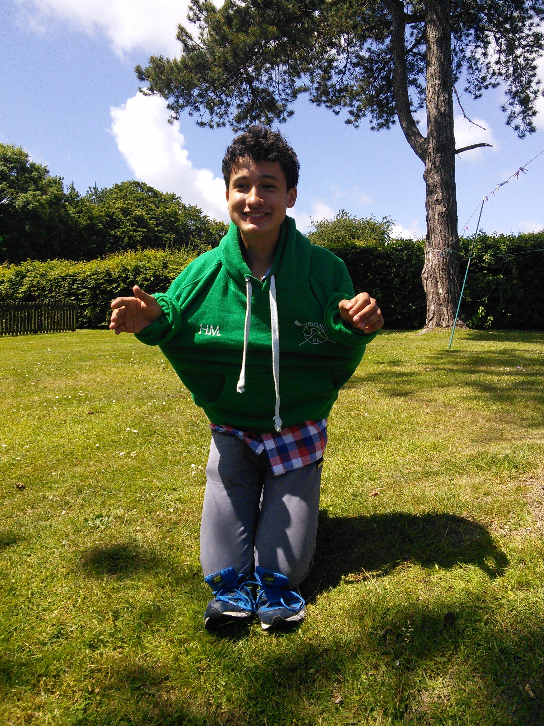
Zacchaeus
He was short.
He was a tax collector.
He was wealthy.
He was not liked.

Slide 3
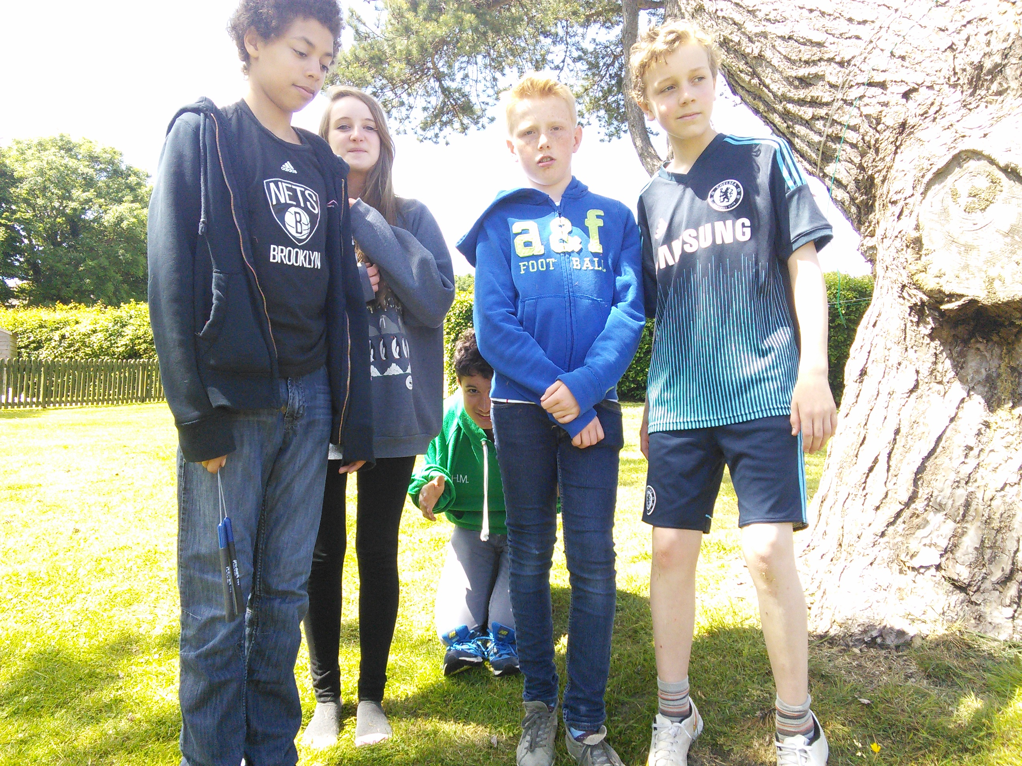
Jesus was coming to town…
Zacchaeus could not see…

Slide 4
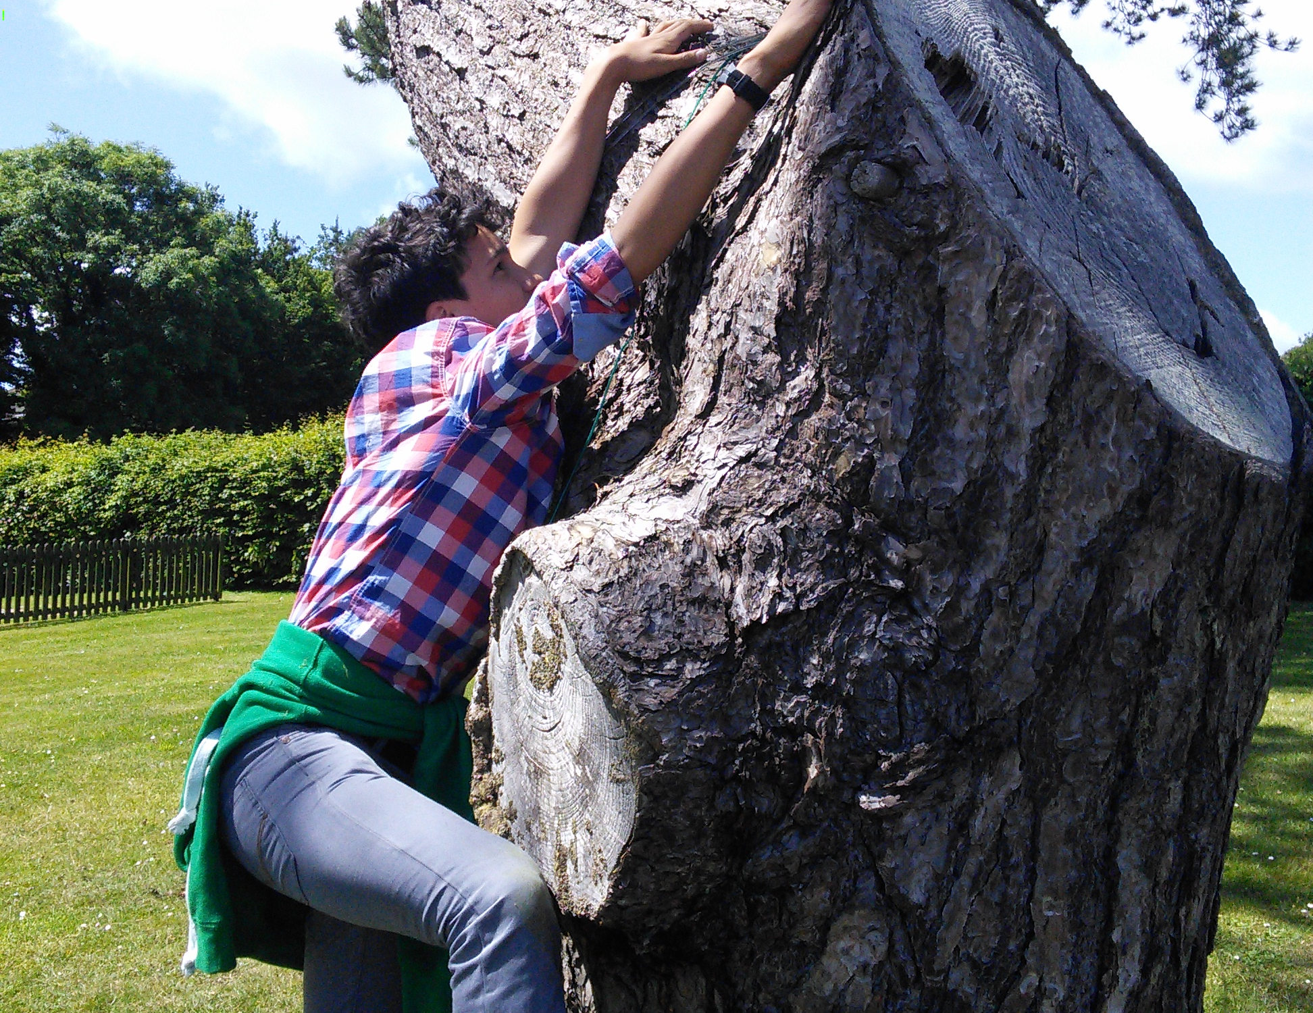
In order to see Jesus he climbed a tree

Slide 5
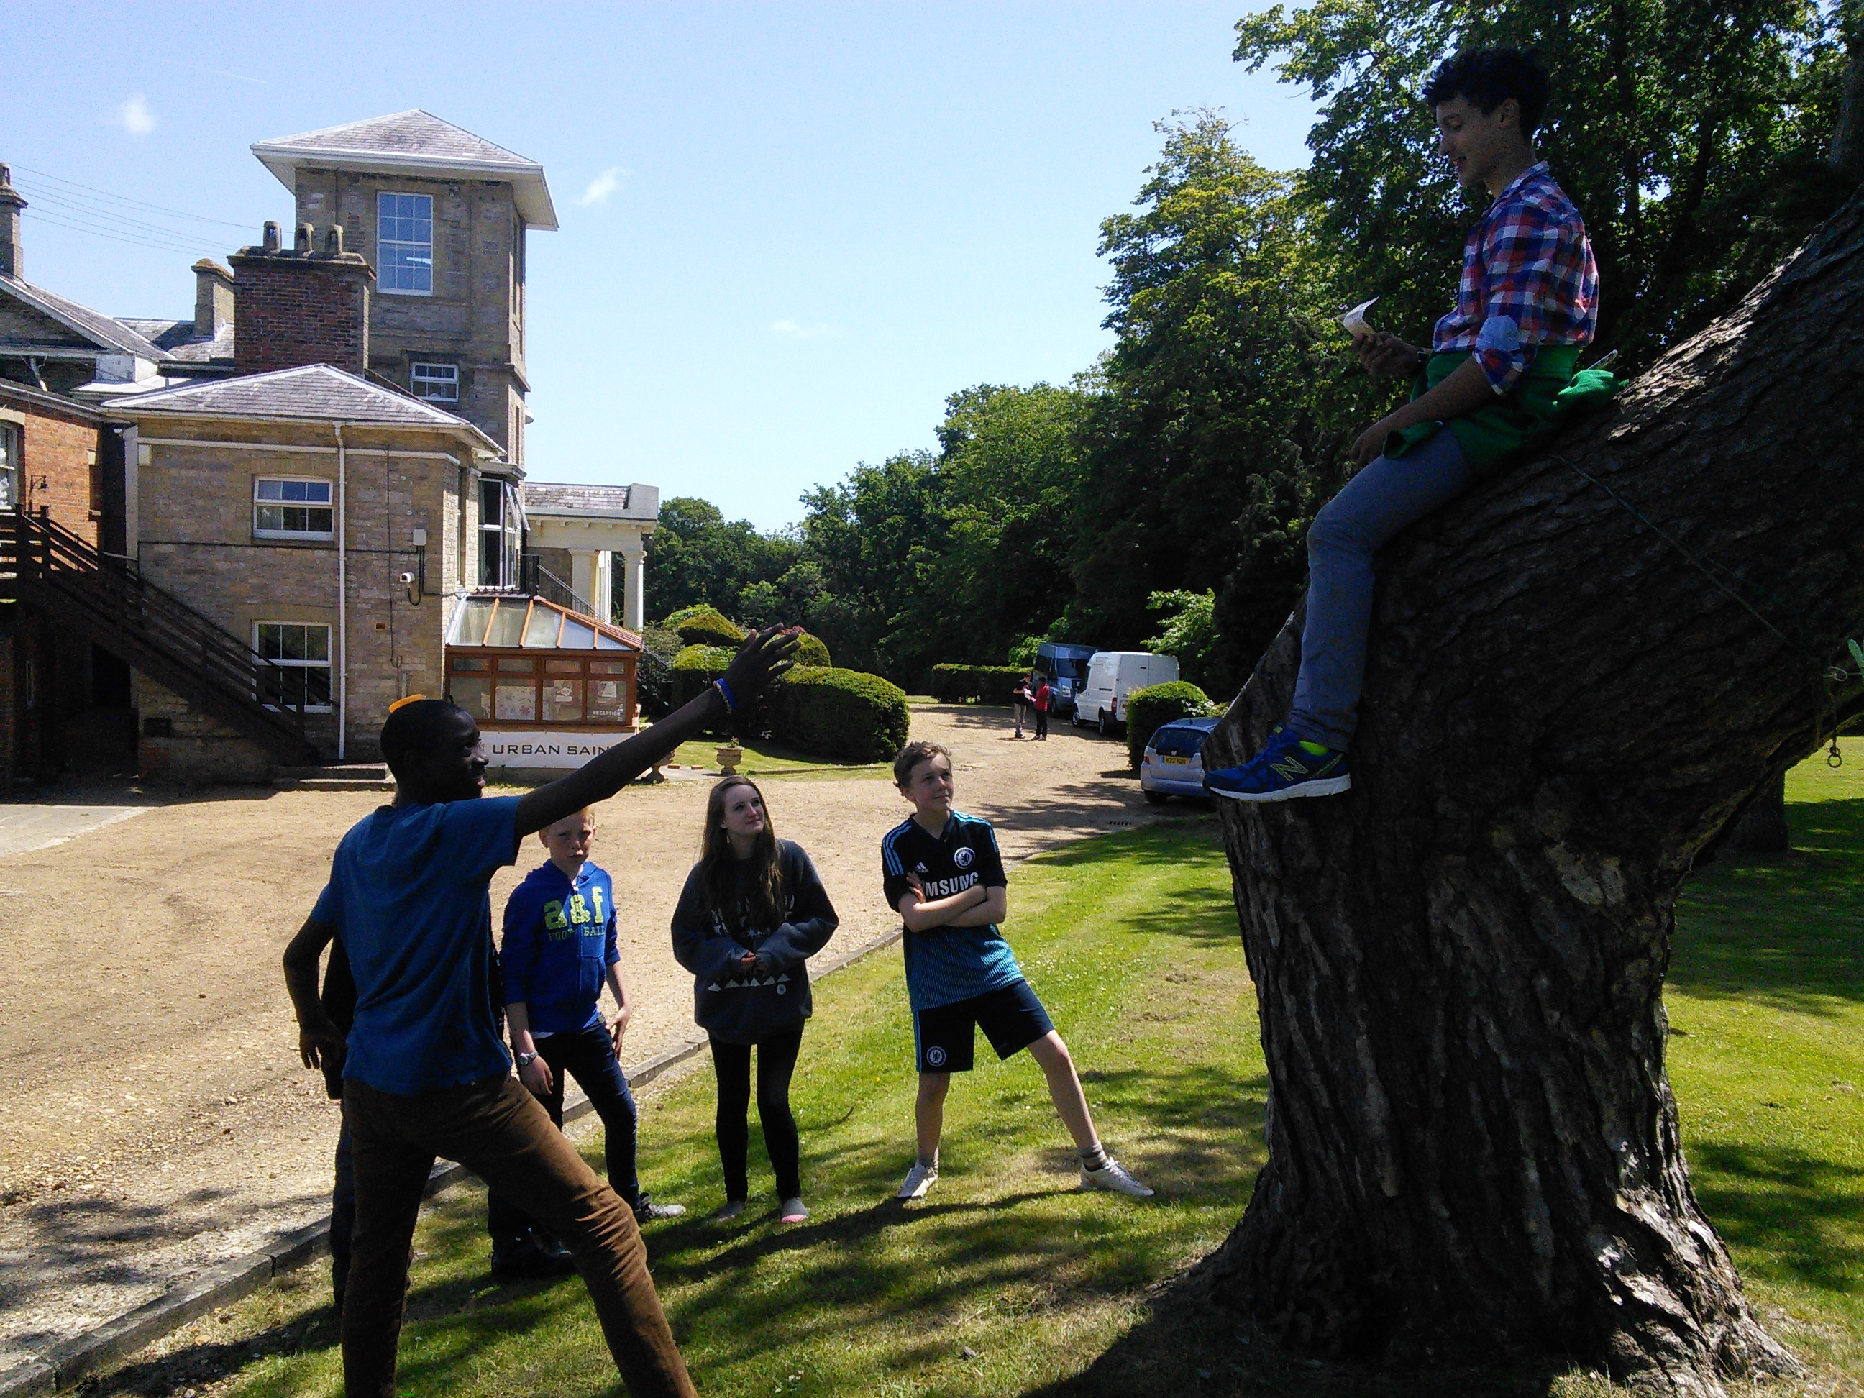
Jesus said to Zacchaeus,
“come down, I must stay at your house today.”

Slide 6
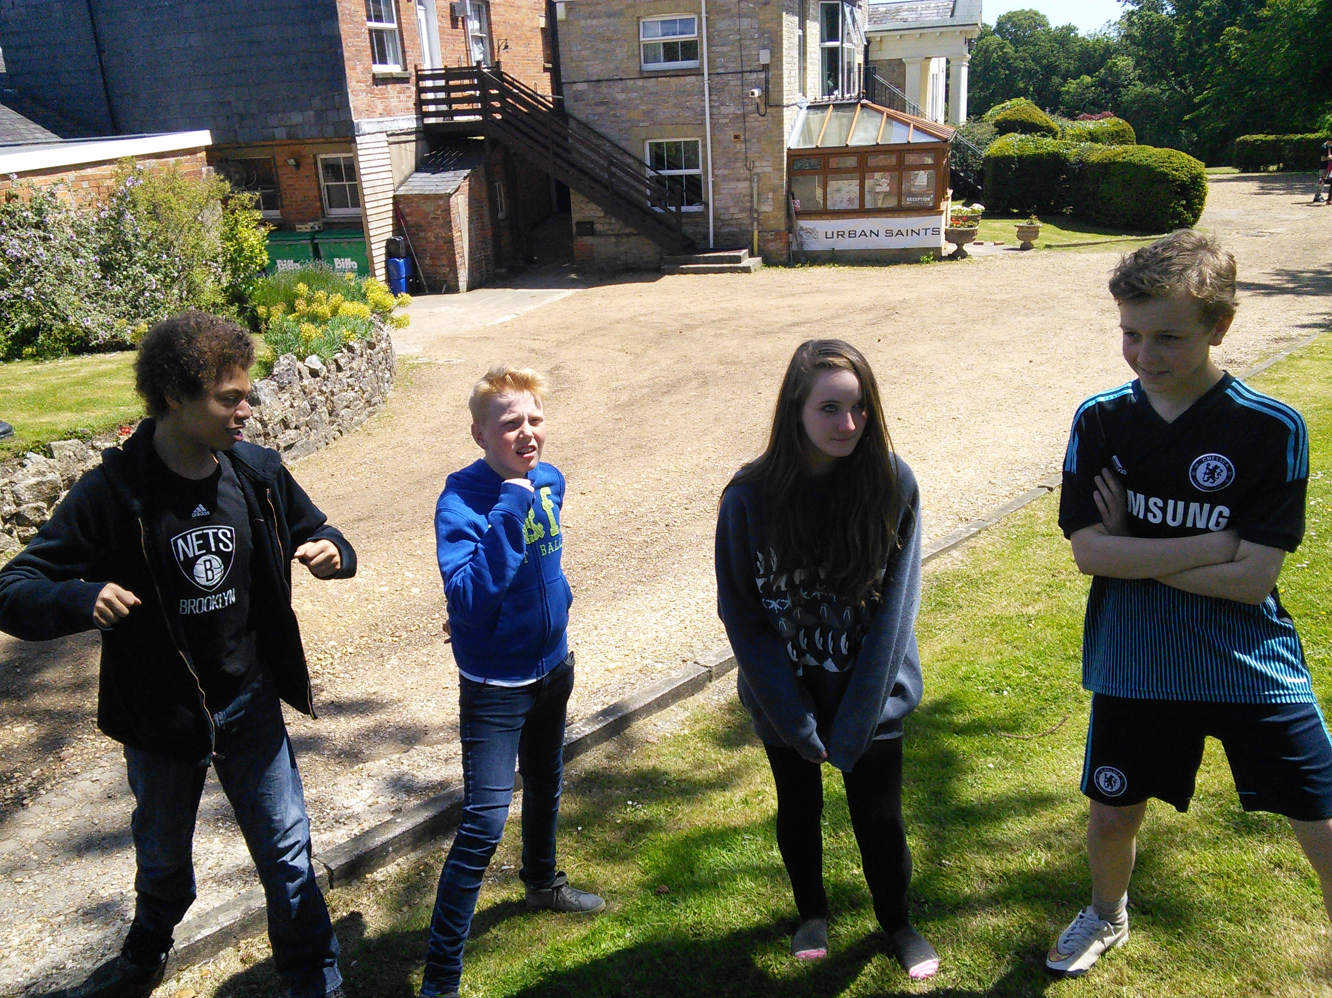
The people began to mutter….they said “Jesus has gone to be the guest of a sinner”

Slide 7
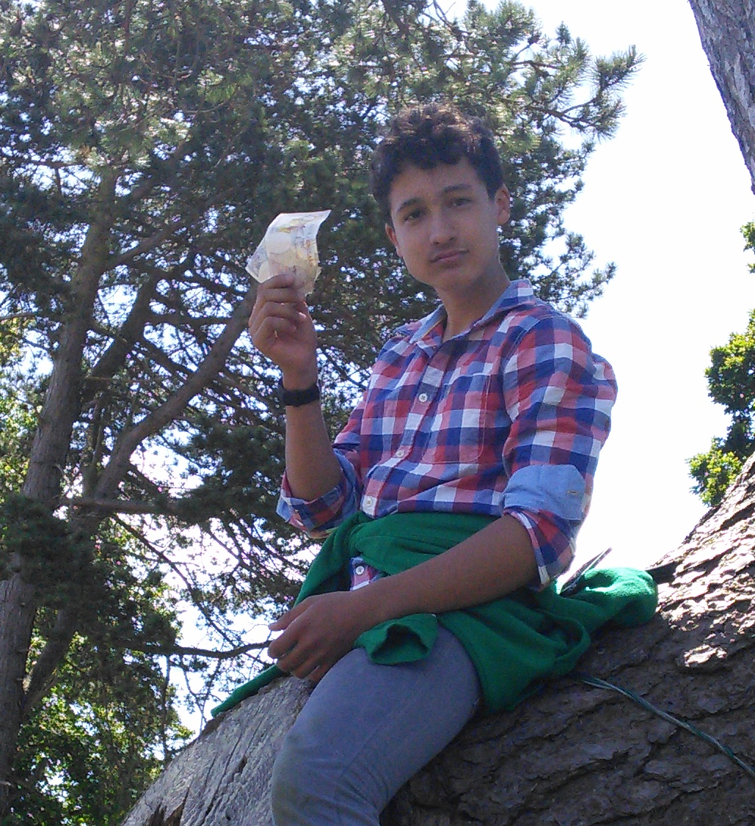
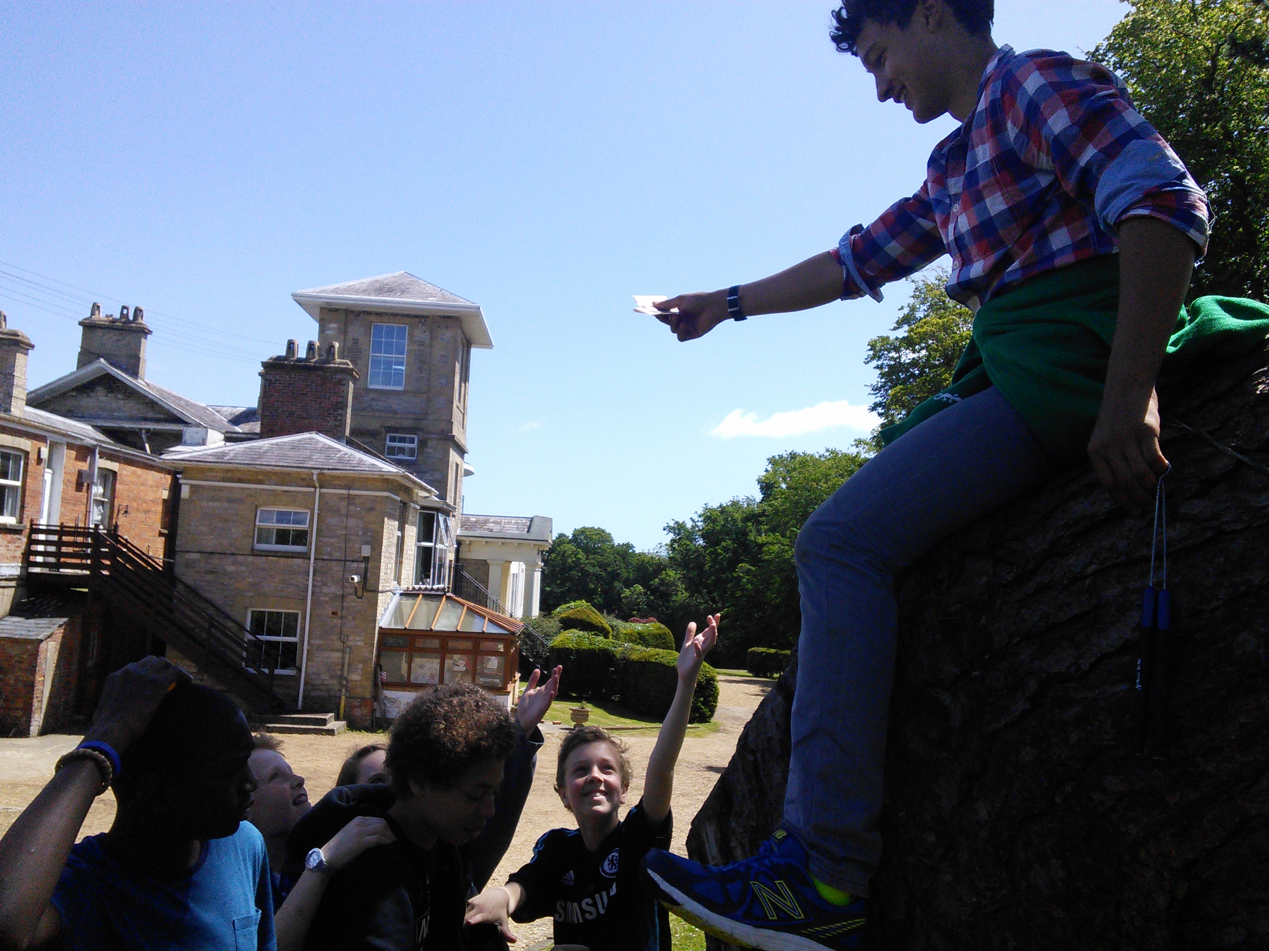
Zacchaeus said “Look, Lord! Here and now I give half of my possessions to the poor, and if I have cheated anyone out of anything, I will pay back four times the amount.”

Slide 8
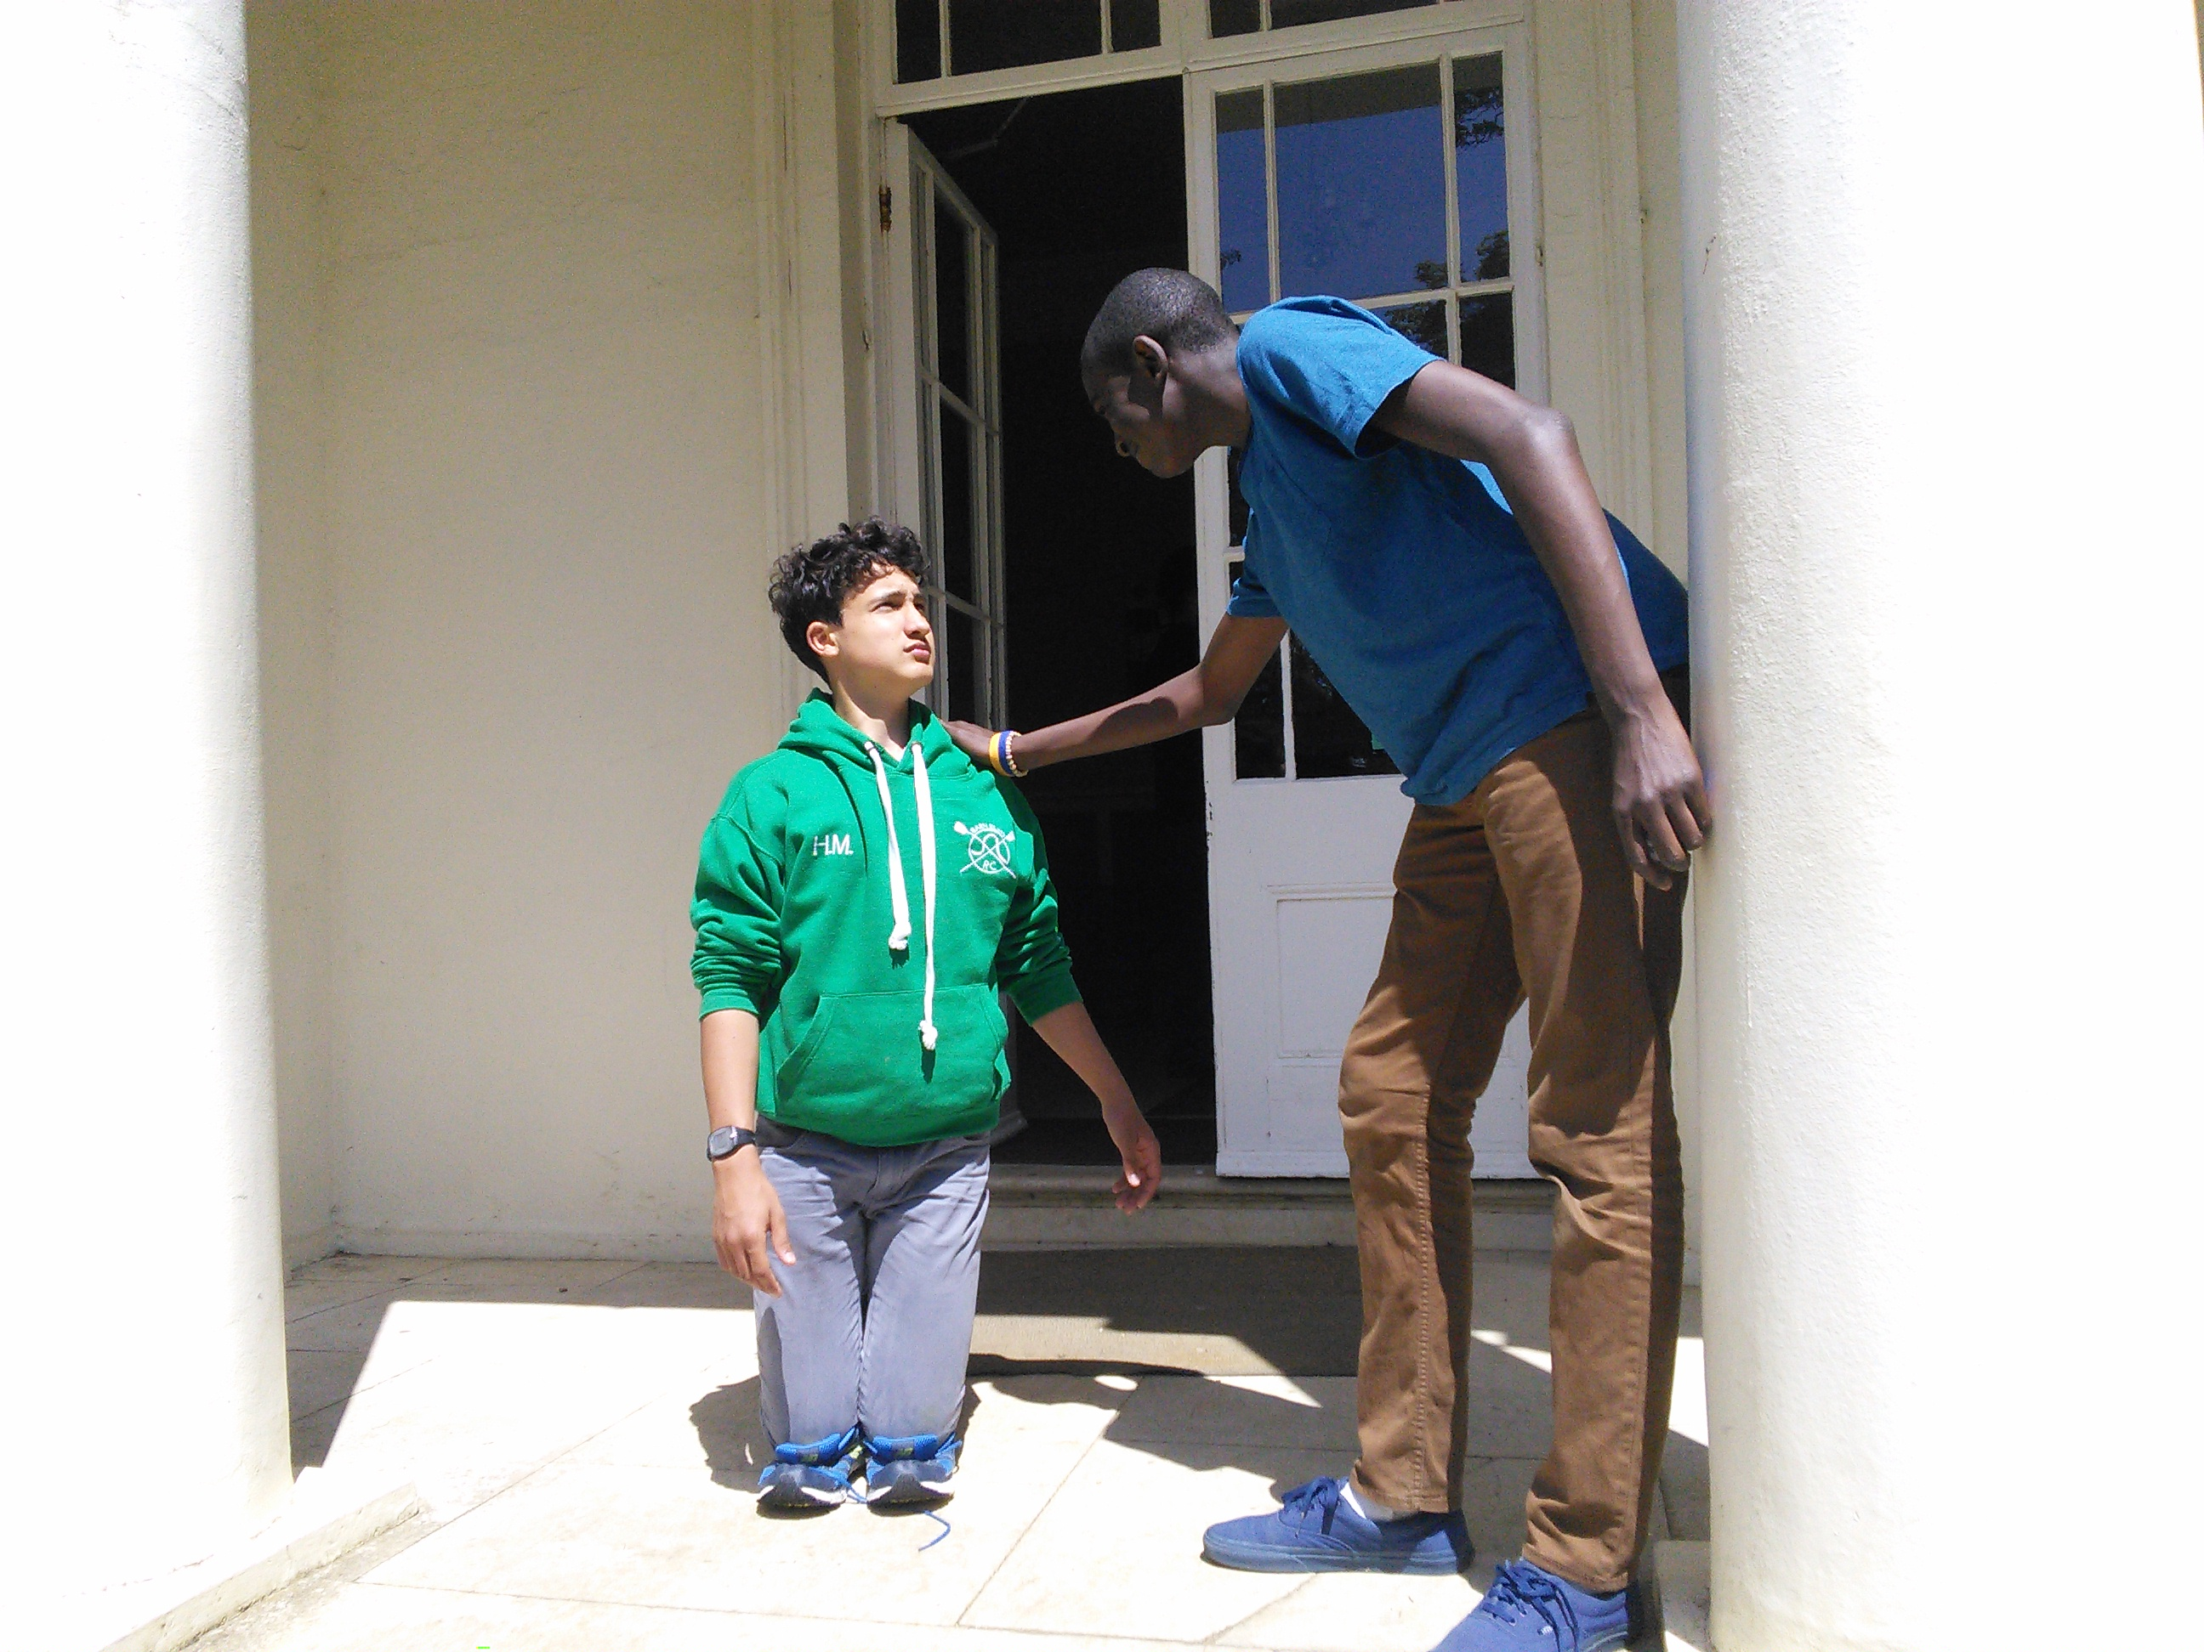
Jesus said to him, “Today salvation has come to this house. Because this man, too, is a son of Abraham. For the Son of Man came to seek and to save the lost.”

