Slide 1
Following Jesus – the Great Commission
Communion
TFG Summer 2015

Slide 3
Gathering
Be with us, Spirit of God;
All nothing can separate us from your love. Breathe on us, breath of God;
All fill us with your saving power. Speak in us, wisdom of God;
All bring strength, healing and peace.

Slide 4
In the name of the Father, and of the Son, and of the Holy Spirit.
All Amen.
The Lord be with you
All and also with you.

Slide 5
Prayer of Preparation
All Almighty God, to whom all hearts are open, all desires known, and from whom no secrets are hidden: cleanse the thoughts of our hearts by the inspiration of your Holy Spirit, that we may perfectly love you, and worthily magnify your holy name; through Christ our Lord.
Amen.

Slide 6
Confession
God our Father, we come to you in sorrow for our sins. For turning away from you,
and ignoring your will for our lives;
Father, forgive us:
All save us and help us.
For behaving just as we wish, without thinking of you; Father, forgive us:
All save us and help us.

Slide 7
Confession
For failing you by what we do, and think and say;
Father, forgive us:
All save us and help us.
For letting ourselves be drawn away from you by temptations in the world about us; Father, forgive us:
All save us and help us.

Slide 8
Confession
For living as if we were ashamed to belong to your Son; Father, forgive us:
All save us and help us.

Slide 9
Absolution
May the Father forgive us by the death of his Son,
and strengthen us to live in the power of the Spirit all our days.
All Amen.

Slide 10
Collect
Heavenly Father, at the Jordan you revealed Jesus as your Son: may we recognize him as Lord and know ourselves to be your beloved children; through Jesus Christ our Saviour.
All Amen.

Slide 11
Reading - Matthew 28:16-20
The Commissioning of the Disciples
¹⁶ Now the eleven disciples went to Galilee, to the mountain to which Jesus had directed them. ¹⁷ When they saw him, they worshipped him; but some doubted. ¹⁸ And Jesus came and said to them, ‘All authority in heaven and on earth has been given to me. ¹⁹ Go therefore and make disciples of all nations, baptizing them in the name of the Father and of the Son and of the Holy Spirit, ²⁰ and teaching them to obey everything that I have commanded you. And remember, I am with you always, to the end of the age.’
This is the gospel of the Lord.
All Praise to you, O Christ.

Slide 12
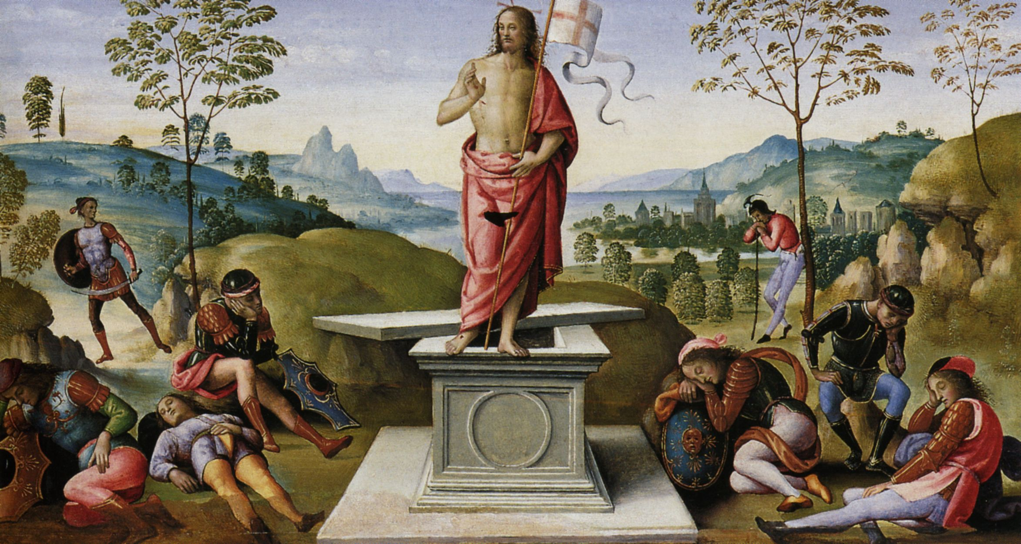
Talk

Slide 14
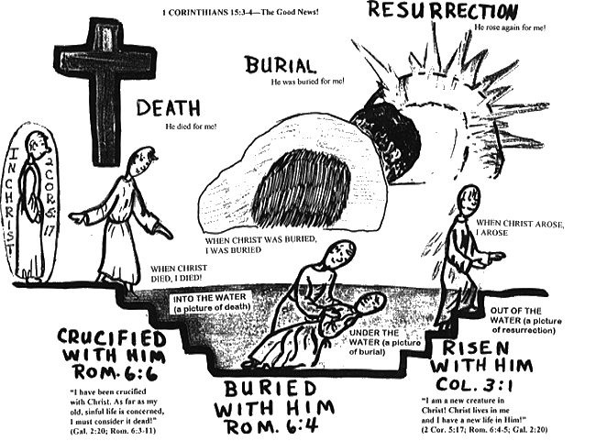

Slide 18
Prayers

Slide 19
The Peace
The minister introduces the Peace.
God has made us one in Christ. He has set his seal upon us and, as a pledge of what is to come, has given the Spirit to dwell in our hearts. Alleluia.
The peace of the Lord be always with you
All reply : and also with you.
All may offer each other a sign of peace.

Slide 20
Interviews

Slide 21
Offertory
As the grain once scattered in the fields
and the grapes once dispersed on the hillside
are now reunited on this table in bread and wine,
so, Lord, may your whole Church
soon be gathered together
from the corners of the earth into your kingdom. All Amen.

Slide 22
The Lord be with you.
All And also with you.
Lift up your hearts.
All We lift them to the Lord.
Let us give thanks to the Lord our God.
All It is right to give thanks and praise.

Slide 23
It is right to praise you, Father, Lord of all creation;
in your love you made us for yourself. When we turned away you did not reject us, but came to met us in your Son.
You embraced us as your children
and welcomed us to sit and eat with you.
In Christ you shared our life, that we might live in him and he in us
He opened his arms of love upon the cross
And made for all the perfect sacrifice for sin

Slide 24
On the night he was betrayed, at supper with his friends, he took bread and gave you thanks; he broke it and gave it to them saying: Take, eat; this is my body which is give for you;
do this in remembrance of me.
Father we do this in remembrance of him;
His body is the bread of life.

Slide 25
At the end of supper, taking the cup of wine, he gave you thanks and said: Drink this all of you; this is my blood of the new covenant which is shed for you for the forgiveness of sins;
do this in remembrance of me.
Father we did this in remembrance of him:
His blood is shed for all.

Slide 26
As we proclaim his death and celebrate his rising in glory,
send your Holy Spirit that this bread and this wine
may be to us the body and blood of your dear Son.
As we eat and drink these holy gifts
Make us one in Christ our risen Lord.

Slide 27
With your whole Church throughout the world we offer you this sacrifice of praise and lift our voice to join the eternal song of heaven:
All Holy, holy, holy Lord, God of power and might, Heaven and earth are full of your glory. Hosanna in the highest.

Slide 28
The Lord’s Prayer
All Our Father in heaven, hallowed be your name, your kingdom come, your will be done, on earth as in heaven. Give us today our daily bread. Forgive us our sins as we forgive those who sin against us. Lead us not into temptation but deliver us from evil. For the kingdom, the power, and the glory are yours now and for ever. Amen.

Slide 29
Breaking of the Bread
We break this bread to share in the body of Christ.
All Though we are many, we are one body, because we all share in one bread.

Slide 31
Prayer after Communion
All Almighty God we thank you for feeding us with the body and blood of your Son Jesus Christ. Through him we offer our souls and bodies to be a living sacrifice. Send us out in the power of your Spirit to live and work
to your praise and glory. Amen.

Slide 32
Blessing
Go in the peace of Christ.
All Thanks be to God.

Slide 33
Dismissal
Go in the peace of Christ.
All Thanks be to God.

